Slide 1
NOC Technology Roadmap
14th Feb 19

Slide 2
Agenda
Objectives
Maturity Model
Team Structure
Next Steps
QnA

Slide 3
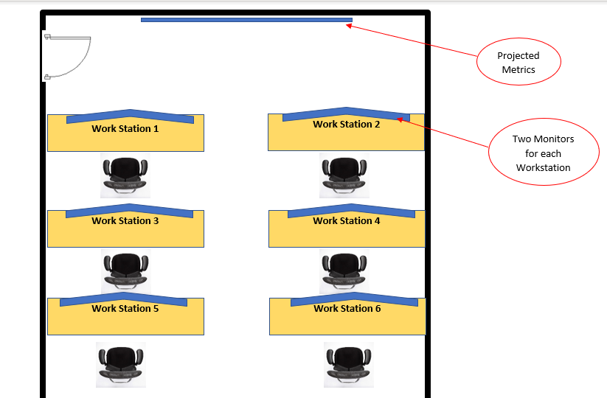
Launch Setup

Slide 4
Launch Readiness
Plan Setup - Done
Spec out the required machines - Done
Procure Equipment – In Progress
Set up Equipment - Pending
Set up the layout – Pending

Slide 5
Agenda
Objectives
Maturity Model
Team Structure
Next Steps
QnA

Slide 6
Objectives
We want to be able to tell the LIVE status of our network(s)
We want to ensure that the RIGHT people are informed in case there is an issue and that issues are resolved as close to the customer/agent as possible
We want to ensure that the people who are actively restoring the service have the NECESSARY information to take correct actions
We will actively reduce the manual intervention required to manage the fleet and bias heavily to AUTOMATION and fixing underlying issues
We want to be able to support the continued GROWTH of our fleet across multiple countries

Slide 7
NOC Landscape and Maturity Model
Stage 1
Stage 2
Stage 3
Stage 4
Nairobi Pilot
15 KP’s
1 SDS
1 STS
Hard Launch
700+ KP’s
10 SDS
10 STS
1 million + KP heartbeats daily
Mombasa Launch / Q4 2019
Large Geographical area to manage
Cloud infrastructure costs are material
Beyond Kenya/ 2020
IOT fleet observability is a core service offering to our partners
Third parties maintaining KOKO equipment

Slide 8
NOC Stage 1: Pilot
Dashboards easily show all of the KPs in one visualization
Wallboards are easy to analyze
Current status of KPs understood
Dashboards are built to serve 15KPs
Tableau (with some KOKO admin major driver)
Will not scale

Slide 9
NOC Stage 2: Hard Launch
Update and replace existing Tableau dashboards ready to scale up Nairobi
Exception based reporting for the KP fleet
Prioritization of events coming in from devices
Access of the field issues to the right stakeholders
SLAs defined
BI analytics and live monitoring separated out for KPs
Launch Team Recruited
Tableau in place (needs to be replaced)
Tableau refreshed, SLAs defined, NOC Tech Team recruited

Slide 10
NOC Stage 3: Mombasa Launch (Q4 2019 timeframe)
End to end process tracing (for all of the key process)
Move to purpose built tech (reduce our dependence on Tableau)
Escalation matrix and communication matrix built into our tech choices
Data storage and access optimizations, bias towards streaming data analytics
SLA based management and monitoring of all of the key business processes
Scale up of existing tools and processes to support expansion in Kenya

Slide 11
NOC Stage 4: Beyond Kenya Prep (2020)
NOC Tech as a service to our partners
SLA based service provision of our NOC Tech to our partners
Third parties performing maintenance on KOKO equipment
Potential third party developers interfacing with our systems
Engagement model for expansion will be the key driver of technology roadmap

Slide 12
Important Business Questions: Mombasa
Do we intend to have our own maintenance team in Mombasa using our planned tools? (Yes – it will just be an extension of Nairobi)
Do we intend to have dedicated people managing a Mombasa NOC? (No, same team)
We will manage the Mombasa network from Nairobi, the team will just be an extension of what we have

Slide 13
Important Business Questions: Zanzibar
What is the charging model for the partner there? How much of that are the NOC tools meant / are allowed to cost?
What SLA’s will we give the partner? What penalties exist for breaching our SLA’s
How will we manage inbound feature requests for NOC tools from our partners?
How technically skilled do we expect their team to be? Should they hire developers?
Do we expect that they will use our tools as they currently exist or will we need to integrate to their ticketing systems?
We expect that there is going to be 1 person running the entire network in ZNZ

Slide 14
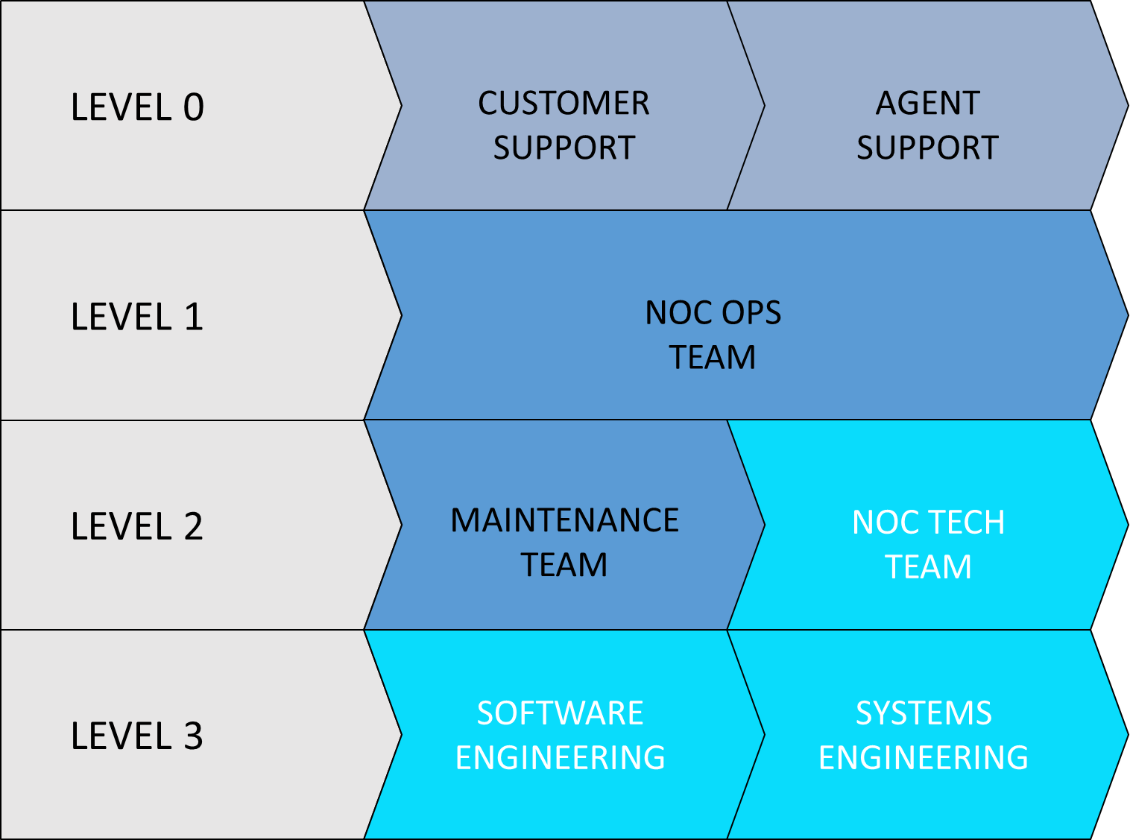
NOC Teams – Support Levels
Target
85%
11%
3%
1%
Notes:
Dark blue teams are local teams/ market specific
Light blue teams are “Global” teams that serve all of the KOKO teams
NOC Operations:
- Monitor live dashboards - Real Time and Live Support to teams in the field - Suggest improvements to NOC Technology - Suggest improvements to field tech - Escalate to the correct teams - Resolve issues (rate TBD) - Maintain escalation matrix
Maintenance Team
- Escalation point from the NOC Ops Team - Resolve issues in the field - Escalate to relevant teams for unresolved issues (hit rate has to be in the high 90%'s by this point)
NOC Technology Team:
- Escalation of issues from the NOC Ops Team - Build out of the NOC technology - Resolving issues that are config/scripting etc (long term objective) - Escalation of issues to the relevant teams

Slide 15
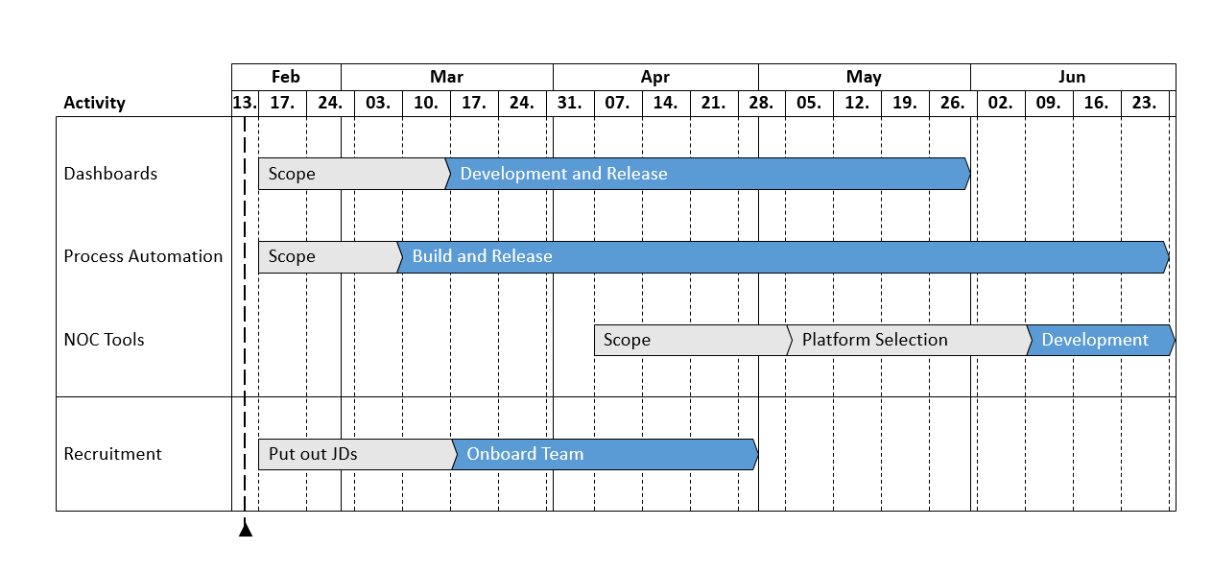
Next Steps

Slide 16
Questions

Slide 17
Appendix

Slide 18
Hard Launch: New Requirements
System health information for all systems (Out of service/in service)
Power status information for all of the systems
Connectivity status for all of the systems
Fuel status information for all of the systems
Auto create helpdesk ticket for an out of service system
Auto close helpdesk ticket for a "back in service" system

Slide 19
Hard Launch: New Requirements (Design)
We will use the following design patterns to try and represent the data for now:
Summary & Details view
Grid Heatmap view
Map Data view
Notes:
Show example mockups

Slide 20
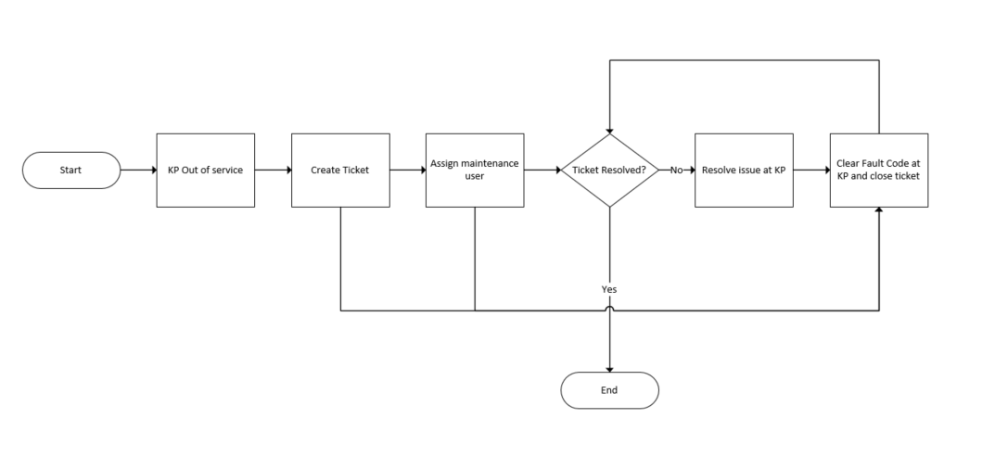
KP Out of Service Resolution (WIP)
Notes:
Example process that we are going to fully automate with NOC tech

Slide 21
Key Business Processes
 |  | Systems affected
Priority | Business Process Area | KP | STS | SDS | KOA
 | Can we be able to dispense fuel to a customer sucessfully | - Does the KP have connectivity - Does the KP have power - Is the KP out of service - Does the KP have enough fuel | N/A | N/A | N/A
P2 | Can we be able to refill a KP succesfully | - Does the KP have connectivity - Does the KP have power (to last the time of refill) - Is the KP out of service | - Does the STS have connectivity - Is the STS out of service | - Does the SDS have connectivity - Is the SDS out of service | - Does the KOA have an issue
P3 | Are we able to play ads to a customer succesfully | - Does the KP have connectivity - Does the KP have power - Is the KP out of service - Is our ads platform provider up and running - how long is the ad buffering for | N/A | N/A | N/A
P4 | Are we able to play radio in the store | - Does the KP have connectivity - Does the KP have power - Is the KP out of service - Is our radio platform provider up and running | N/A | N/A | N/A
P1 | Is the KP out of service due to a HSE concern | - is there a fuel leak - is it too hot inside the KP | N/A | N/A | N/A
Notes:
Example process that we are going to fully automate with NOC tech

Slide 22
Incident Communication Matrix (NOC Ops TBD)
Urgency | Impact
 | Extensive | Major | Moderate | Minor | Insignificant
Very High | P0 | P0 | P2 | P2 | P4
High | P0 | P1 | P2 | P3 | P4
Moderate | P1 | P1 | P3 | P3 | P4
Low | P1 | P2 | P3 | P3 | P4
Very Low | P2 | P2 | P3 | P3 | P4
Priority Code | Description | Target Response Time | Target Resolution Time
P0 | Critical | Immediate | 1 Hour
P1 | High | 10 Minutes | 4 Hours
P2 | Medium | 1 Hour | 8 Hours
P3 | Low | 4 Hours | 24 Hours
P4 | Very low | 1 Day | 1 Week
Incident Priority | Affected Customers | System/Network Impaired Time | MTTR Breaking | HSEQ Violation | No. of Departments Involved | % of Stakeholders to be notified
P0 | Over 60% | More than 6 hours | P1 Breaking | Over 60% | More than 2 | Over 80%
P1 | Between 40%-60% | Between 3-6 hours | P2 Breaking | Between 40%-60% | 1/2 | Between 60%-80%
P2 | Between 20%-40% | Between 2-3 hours | P3 Breaking | Between 25%-40% | 1 | Between 40%-60%
P3 | Between 5%-20% | Between 1-2 hours | P4 Breaking | Between 5%-20% | 1 | Between 10%-40%
P4 | Between 1%-5% | Less than 1 hour | Notification/Warning | Between 1%-5% | 0 | Between 1%-10%

Slide 23
KP Streaming Data Analysis (High Level Architecture)
KP 1
KOKO Admin API
Aggregation
Totals
Monthly Reports
KP 2
KP3
Augmentation
Archive
Dashboards
KP n
STS n
Realtime Analysis
Results
Realtime Responses
SDS n
Anomaly Detection

Slide 24
NOC Tech Team Structure
NOC Tech Manager
NOC Product Analyst
NOC Tech Team
NOC Engineer
NOC Engineer
NOC Engineer
NOC Engineer
Role | Responsibilities | Skill Set
NOC Technology Manager | - Manage the team NOC Tech Team - Design technology solutions for the NOC - Plan the future of the NOC | - Server and infrastructure management - IOT fleet management - Scripting and SQL skills - Data storage and access expertise
NOC Engineer | - Build out the tech required to manage the NOC - L2 support for the NOC | - SQL /Server side dev - Devops background - BI background
NOC Engineer | - Build out the tech required to manage the NOC - L2 support for the NOC | - SQL /Server side dev - Devops background - BI background
NOC Engineer | - Build out the tech required to manage the NOC - L2 support for the NOC | - SQL /Server side dev - Devops background - BI background
NOC Engineer | - Build out the tech required to manage the NOC - L2 support for the NOC | - Android /Mobile dev background - Devops background - BI background
Product Analyst | - Manage the Network ops backlog - Build out NOC documentation | - Product analyst in an IOT based organization

